Slide 1
CARDIO DISEASE MONITORING AND PULSE CHECKER
Done By:
Aisha Farheen Rasheed A
Roll No: 04

Slide 2
TABLE OF CONTENTS
1
2
3
4
5
6
Project Title
Relevance of topic
A Description of the Project
Objectives of the Study
Existing System and Proposed System
Input/ Output and Modules identified.

Slide 3
01
PROJECT TITLE AND DESCRIPTION OF THE PROJECT

Slide 4
The Heart Disease Prediction application is an end user support and online consultation project. Here, we propose a android application that allows users to get instant guidance on their heart disease through an intelligent system online. The application is fed with various details and the heart disease associated with those details. The application allows user to share their heart related issues. It then processes user specific details to check for various illness that could be associated with it. Here we use some intelligent data mining techniques to guess the most accurate illness that could be associated with patient’s details. Based on result, the can contact doctor accordingly for further treatment. The system allows user to view doctor’s details too. The system can be used for free heart pulse rate online.

Slide 5
02
RELEVANCE OF TOPIC

Slide 6
- It might have happened so many times that you or someone yours need doctors help immediately, but they are not available due to some reason.
-The application is fed with various details and the heart disease associated with those details.
-The application allows user to share their heart related issues.
-It then processes user specific details to check for various illness that could be associated with it.
-Here we use some intelligent data mining techniques to guess the most accurate illness that could be associated with patient’s details.
-Based on result, system automatically shows the result specific doctors for further treatment.
-The system allows user to view doctor’s details.
-The system can be use in case of emergency.

Slide 7

“DO YOUR PART, CARE FOR YOUR HEART.”

Slide 8
03
OBJECTIVES OF THE STUDY

Slide 9
- The Cardio Disease monitoring and pulse checker Android Application has been designed to help users with assessing their cardiovascular health.
- Based on a number of factors such as the user’s age, gender, blood sugar, cholesterol levels, blood pressure, etc. this system generates a prediction about the disease that the user might be suffering from. Moreover, apart from assessing their cardiovascular health, users can also find contact details of various doctors on this application.
- The user can search for doctors by filtering them based on their specialty. Admin is the sole user who manages the training data and can actively change or update any values. Admin is also the person who will manage the doctor & their clinic details, view users & view their feedbacks.
- User on the other hand has to create an account to use the prediction services. User will have to enter 13 data to get a prediction which system uses Random Forest algorithm to predict. User can also update their profile and change the password.

Slide 10
SENSOR FOR CHECKING PULSE
Heart Beat Detection and Monitoring System using Arduino that will detect the heart beat using the Pulse Sensor and will show the readings in BPM (Beats Per Minute) on the USB connected to MOBILE.
Components Required:
-Pulse sensor
-Arduino Uno
-Bread Board
-Connecting wires

Slide 11
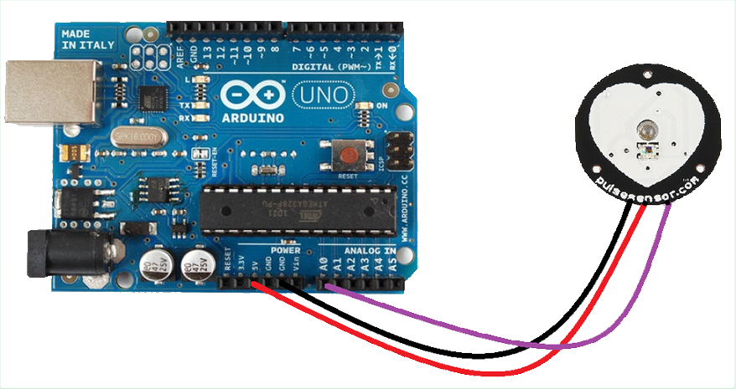

Slide 12
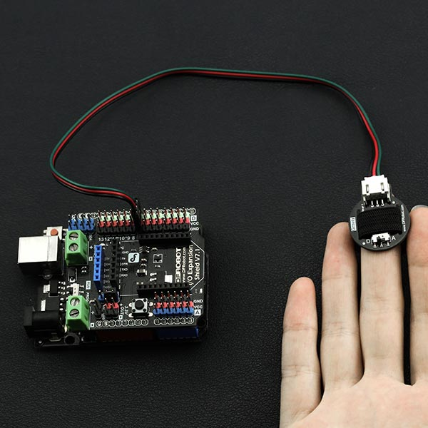
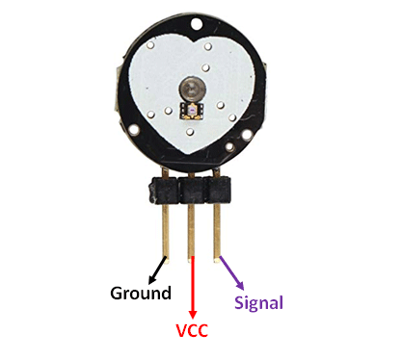

Slide 13
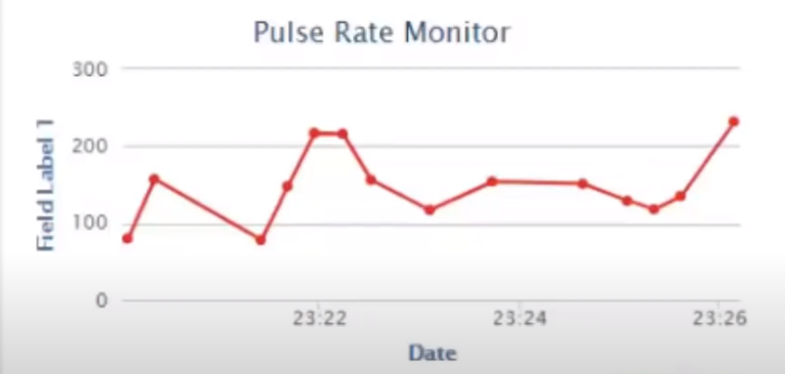

Slide 14
04
EXISTING SYSTEM AND PROPOSED SYSTEM

Slide 15
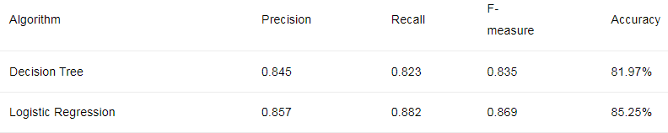
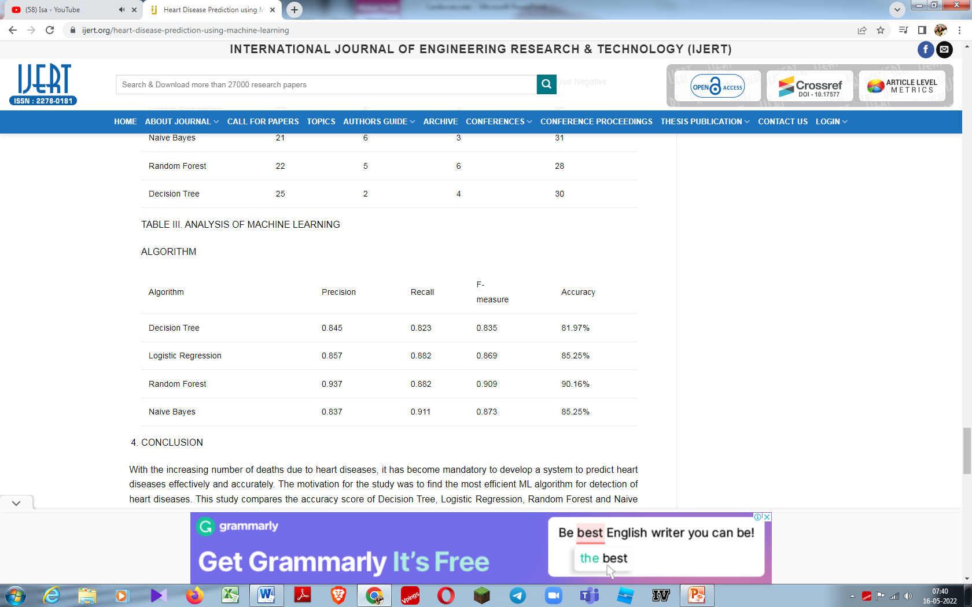
EXISTING MODEL
-The objective of this study is to effectively predict if the patient suffers from heart disease. The health professional enters the input values from the patient's health report.
-The existing work predicts heart disease by explored using naïve Bayes algorithm.
Naive Bayes algorithm is based on the Bayes rule. The independence between the attributes of the dataset is the main assumption and the most important in making a classification.
-It is easy and fast to predict and holds best when the assumption of independence holds. Bayes theorem calculates the posterior probability of an event (A) given some prior probability of event B represented by P(A/B)[10] as shown in
equation 1 : P(A|B) = P(B|A) * P(A) / P(B)

Slide 16
PROPOSED MODEL
-The proposed work predicts heart disease by exploring the above mentioned four classification algorithms and does performance analysis.
-The objective of this study is to effectively predict if the patient suffers from heart disease. The health professional enters the input values from the patient's health report.
-The data is fed into model which predicts the probability of having heart disease. The input dataset is split into 80% of the training dataset and the remaining 20% into the test dataset. Training dataset is the dataset which is used to train a model. Testing dataset is used to check the performance of the trained model.
-Random Forest algorithms are used for classification as well as regression. It creates a tree for the data and makes prediction based on that. Random Forest algorithm can be used on large datasets and can produce the same result even when large sets record values are missing.
-The generated samples from the decision tree can be saved so that it can be used on other data. In random forest there are two stages, firstly create a random forest then make a prediction using a random forest classifier created in the first stage.
-

Slide 17
The Heart Disease prediction will have the following key takeaways:
1
2
3
4
Data insight
Feature engineering
EDA
Model building
we will be working with the heart disease detection dataset and we will be putting out interesting inferences from the data to derive some meaningful results.
Exploratory data analysis is the key step for getting meaningful results.
the insights from the data we have to alter the features so that they can move forward for the model building phase.
we will be building our Machine learning model for heart disease detection.

Slide 18
05
INPUT/ OUTPUT AND MODULES IDENTIFIED.

Slide 19
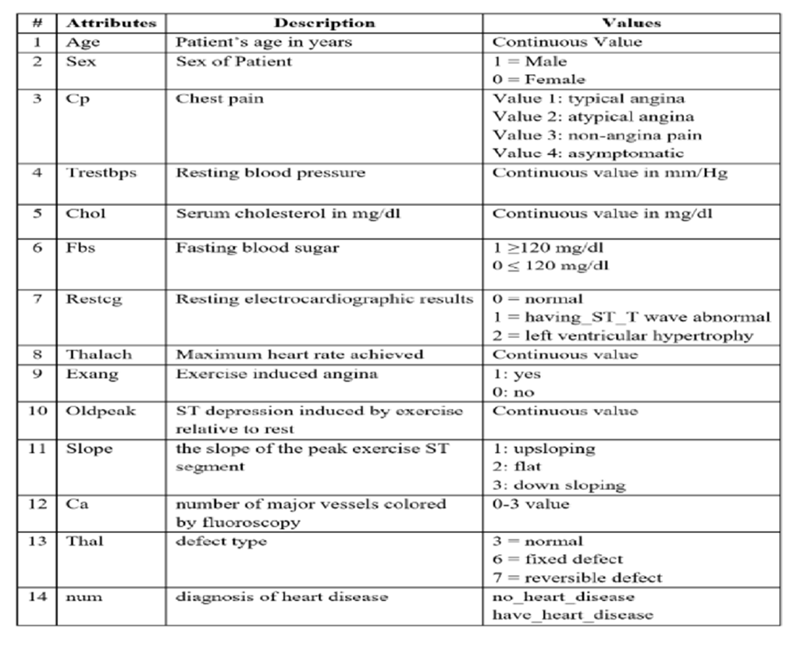
INPUT AND OUTPUT
INPUT:

Slide 20
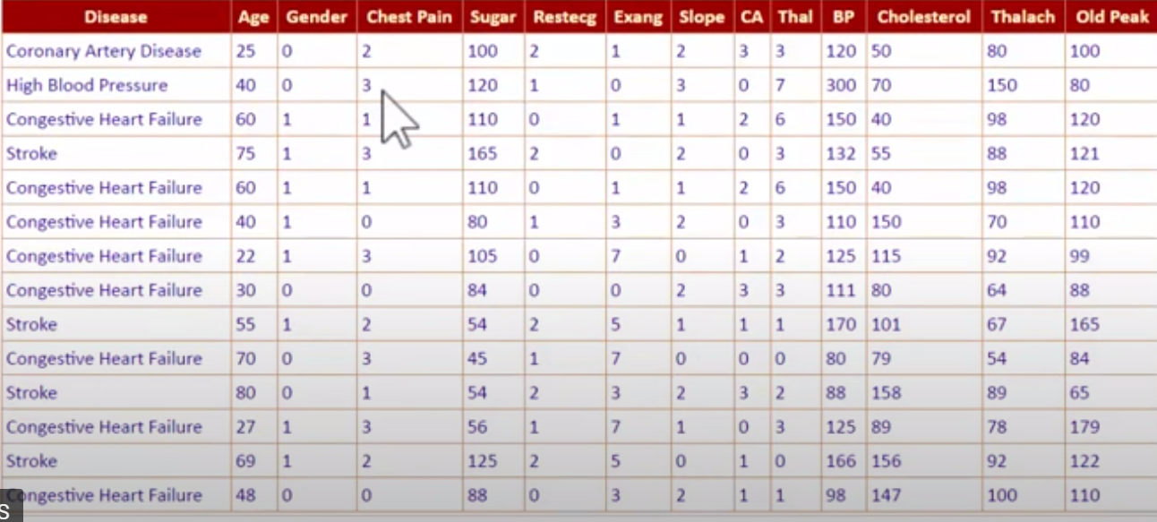
B. OUTPUT:

Slide 21
MODULES DESCRIPTION
There are basically six modules:
CUSTOMER
HEART DISEASES
DOCTER
PULSE RATE
PRODUCT
PAYMENT

Slide 22
1. ADMIN MODULE-
-Add Training Data
-Add Doctor Details
-View User Details
-View Feedback
-View Doc Details
-View Training Data

Slide 23
2. USER MODULE-
-Register (With Details like Age, Sex, etc.)
-Check Heart (By providing Details like
Age in Year
Gender
Chest Pain Type
Fasting Blood Sugar
Resting Electrographic Results(Restecg)
Exercise Induced Angina(Exang)
The slope of the peak exercise ST segment
CA – Number of major vessels colored by fluoroscopy
Thal
Trest Blood Pressure
Serum Cholesterol
Maximum heart rate achieved(Thalach)
ST depression induced by exercise(Oldpeak)
-System will accordingly view Doctor to consult.
-Give Feedback
-View Doctor

Slide 24
05
DATASET
The dataset is taken from kaggle with above 14 parameters to predict the heart diseases.
According to these parameters to predict which heart diseases or not.

Slide 26
ADVANTAGES-
User can search for doctor’s help at any point of time.
User can talk about their Heart Disease and get instant diagnosis.
Doctors get more clients online.
Very useful in case of emergency.

Slide 27
THANK YOU

